Slide 1


[ACCENTURE
Social Buzz’s Data Analysis]
TANMOY BANERJEEE

Slide 2


Today's agenda
Project recap
Problem
The Analytics team
Process
Insights
Summary

Slide 3


Social Buzz is a fast growing technology unicorn that need to adapt quickly to it’s global scale.
Accenture has begun a 3 month POC focusing on these tasks:
An Audit of Social Buzz ‘s Big Data Picture practice
Recommendations of a successful IPO
Analysis to find Social Buzz’s top 5 most popular categories of content
Project Recap

Slide 4


Problem
Over 100000 Posts per day
36,500,000 pieces of content per year
But how to capitalize on it when there is so much?
Analysis to find Social Buzz’s top 5 most popular categories of content

Slide 5



Tanmoy Banerjee
Data Analyst
The Analytics team
Marcus Rompton
Senior Architect
Andrew Flemiong
Chief Data Architect

Slide 6

Process
1
Data Understanding
2
Data Cleaning
3
Data Modelling
4
Data Analysis
5
Uncover Insights

Slide 7
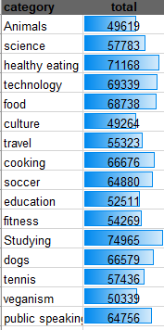
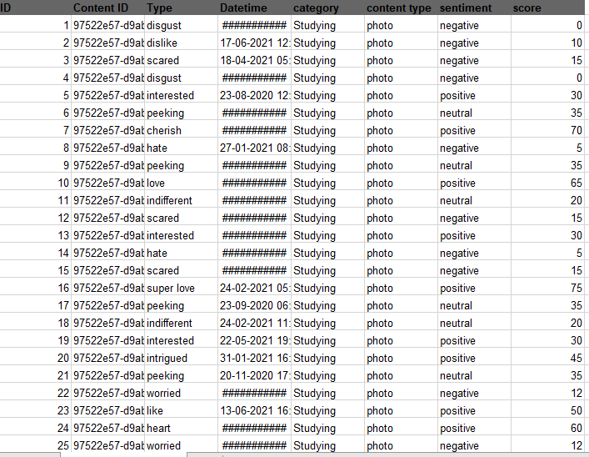


Insights
Top 5 Categories

Slide 8
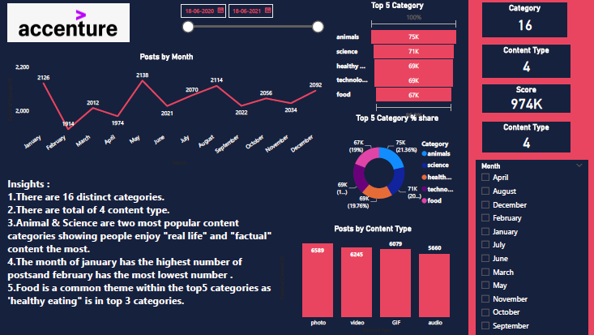

Slide 9
Insights :
1.There are 16 distinct categories.
2.There are total of 4 content type.
3.Animal & Science are two most popular content categories showing people enjoy "real life" and "factual" content the most.
4.The month of jan has the highest number of posts and feb has the most lowest number .
5.Food is a common theme within the top5 categories as 'healthy eating" is in top 3 categories.

Slide 10

Thank you!
ANY QUESTIONS?

